Slide 1
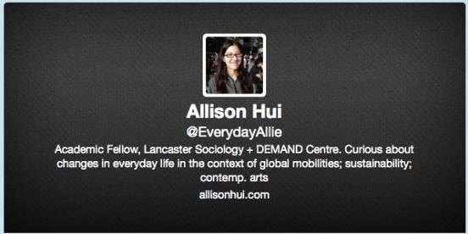
Intersections of mobilities, practices, and futures
Dr Allison Hui, DEMAND Centre & Sociology Department, Lancaster University
Notes:
Based in Sociology + DEMAND Centre – speak more about in a moment
Also on Twitter – feel free to live tweet

Slide 2
Intersections
Notes:
Decided to focus my reflections today around intersections as a metaphor
Workshop – bringing together mobilities and design
My own work bringing together mobilities and theories of practice – particularly focusing on how everyday life is changing in the context of global mobilities
Interested in starting off with intersections as a metaphor then because of how it can be useful for thinking about academic work and interdisciplinary challenges

Slide 3
Meeting-place
Notes:
On one hand, intersections can be seen as meeting places
Point of contact
Highlighting the importance of encounters
Offering potential of exchange because of coming together

Slide 4
Enabling new flows
Notes:
Intersections in this way can enable new flows – of ideas and information; of expected or unexpected nature
Coming to intersections then offers possibility of re-direction, finding less-trod paths a la Frost

Slide 5
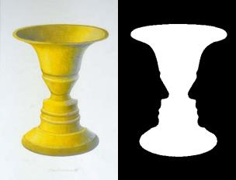
Marking out space
Notes:
Intersections not just exchange and movement – also marking out of space
Delineation, demarcation
But not always clear which space
Roads mark out areas for cars at same time as areas not for them – making appropriate spaces for vehicles but also flowers, grasses and weeds
As with optical illusions – articulation of intersections is also the articulation of the spaces around them
Attention can switch from one to the other
What they are making space for and what they are holding back changes
Intersections provide different possible focuses

Slide 6
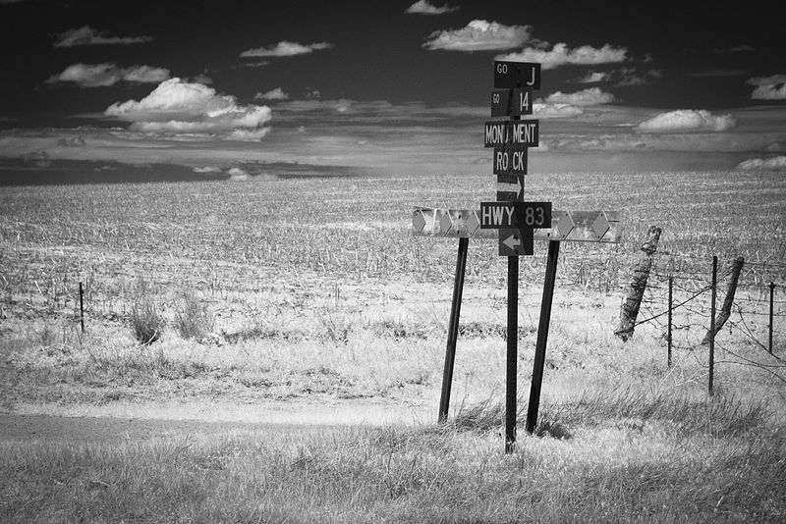
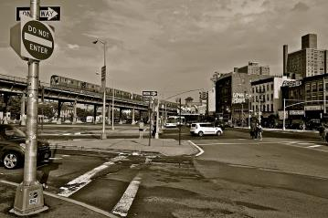
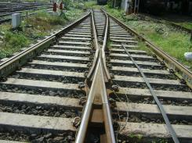
Sameness and difference
Notes:
So at once intersections – whether material or conceptual, can articulate sameness and difference
Bring into attention things that are shared – by design or by accident
But also marking out contrasts and alternatives – areas of difference and divergence
Intersections always marked by ambiguity
At times as with optical illusions - flickering movement between
At others trying to ignore the multiple aspects of intersections in order to maintain focus on only one
3.00

Slide 7
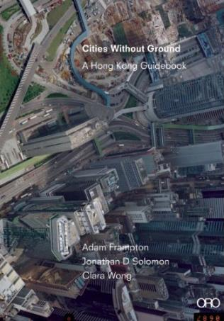
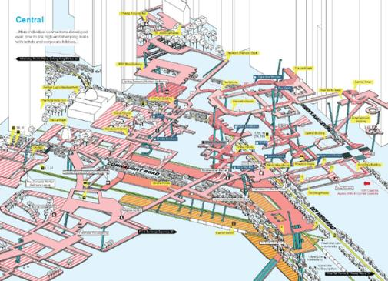
Spaces without ground
Notes:
Of course, spaces aren’t two-dimensional either
Cities like HK can operate as Frampton and colleagues have argued ‘without ground’ – layers of public spaces in shopping complexes, pedestrian or vehicle overpasses, underground tunnels and subway networks that confuse any sense of a ‘ground zero’ from where to measure
These complex structures can lead to multiple layers of intersections – both material and social – gatherings of people and planes of interaction interweave
Similarly, our conceptual and theoretical work can be marked by multiple layered intersections – particularly in the case of interdisciplinary discussions where conventions and concepts draw from different assumptions and preoccupations.
4.15

Slide 8
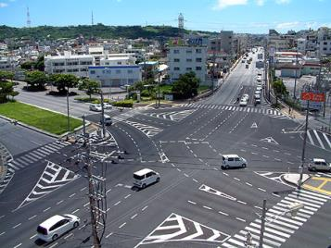
The same different concepts
Notes:
Working at the intersections is not an easy task
Flickering of sameness and difference can be unpredictable
E.g. talking about the same thing – yet meaning different things
Concepts in this way can be meeting points and also markers of difference
Not always easy to figure out which from the complexity
Concepts themselves lead us places
Different understandings of a concept lead us to see different spaces, and enable different types of flows
5.15
(Roger Penrose – stairs – used by Escher)

Slide 9
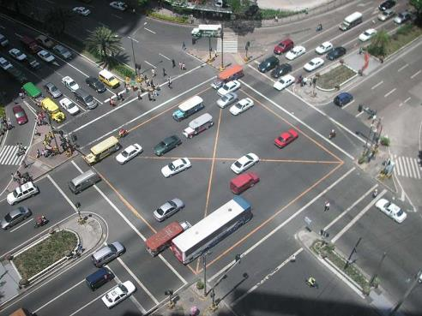
Investigation at the intersections
Notes:
As complicated as these negotiations are, I’ve always found this work interesting
Not necessarily just working at the intersection of disciplines – also of different literatures and sub-disciplines, also intersections between academics and non-academics.
Rewarding to approach these like optical illusions to be seen in multiple ways
working out different articulations of sameness and difference; what is shared, what is not, and when it is useful to recognize either.
5.45

Slide 10
DEMAND Centre
Dynamics of Energy, Mobility and Demand www.demand.ac.uk @DEMAND_CENTRE
Notes:
So excited to gain a fellowship w/ DEMAND Centre starting last summer – b/c working at the intersection of several important areas and concerns
Social scientists funded by EPSRC (engineering and physical sciences) to look at End-Use Energy Demand (and other centers with more engineering etc. focus)
*one intersection of disciplines
Reclaiming and opening up idea of demand – vs. black box for energy companies etc.
*intersection of academic and policy/industry interests
Centre is looking at both Energy and Mobility - *another intersection
Both areas have a relation to sustainability, carbon emissions and reduction targets
But often separate conversations though similar concepts (e.g. ‘peak’ demand – traffic congestion + electricity load)
May be more intersections in future – e.g. Evs, question of where you plug in, when charges, who pays (employer, personal, state)
Valuable space for further investigation of sameness/difference
Centre approaches these intersections then with several key theoretical propositions
First – energy use is a consequence of people’s social practices.
7.30

Slide 11
Theories of Social Practices
Weaker version: people doing something
Stronger version: articulating distinct practices that
are studied as units
are comprised of material and immaterial elements
are performed by people
enact social structures
Notes:
This proposition draws from theories of social practices
But multiple ways ‘practice’ is used in research
Some work draws on a weaker version – people doing something
Instead we take up a Stronger version drawing upon those such as Schatzki and Shove who are building upon previous work by Bourdieu, Giddens
SLIDE
This stronger version is what we take forward
8.45

Slide 12
Steering Demand
Notes:
Centre not interested in design per se – not working with designers
BUT – interest in process of steering demand
How to change patterns of demand to reach governmental emissions targets- 80% fewer greenhouse gas emissions by 2050 (from 1990 baseline)
But interested in steering as more than this
How different professional practices help to constitute demand through projections, assumptions, and the materialities of infrastructures
Also how assumptions of change affect the steering of demand – e.g. change as happening in the future vs. now
e.g. change isn’t just about the future – practices are already changing with daily, weekly, monthly, yearly temporalities and varying flexibilities
How non-energy policy can shape energy demand, likewise with transport demand – (school holiday) (implicit energy governance)
Using idea of ‘practice’ to think about steering – but beyond behaviour change
Not a matter for individuals
Not just convincing people
Thinking through more complex dynamics and interrelations
10.30

Slide 13
Mobilities Practices
Notes:
Only one year in – so work still in progress.
Rest of my time – looking at a key intersection that is part of this – mobilities and practices
When thinking about futures and transformations – need to have clarity around relationship between mobility and practice
How it is understood
Consequences of characterizing it in particular ways
I will outline 4 different ways mobilities and practices might be seen to intersect and interact
Interested in what is or is not being attended to in each reading of this intersection
How different articulations of mobilities and practices direct selective attention
Thinking to the times and places when we want to remain within one version vs. times it is important to move between them
12.00

Slide 14
Way of travelling as a practice
Notes:
1 – seeing different ways of travelling as different practices
e.g. driving a car; riding a bike; flying in an aeroplane – ea different practice
Could look historically at how each different way of travelling by a particular mode of transport evolved and spread across the world
Can isolate new technologies (cars), spaces (motorways, rest stops), and how they change practices
- how one mode had consequences for others – e.g. pedestrians education; new zebra crossings; honing walking skills to avoid collisions
Already a lot of work within mobilities research taking this kind of approach – travel cultures, histories of mobility systems and how came to be designed
This approach obviously accentuates contrasts between modes of transport; can be used to highlight differences between countries and mode-share
But also hides the way we are all intermittently-multi-modally-mobile people
13.50

Slide 15
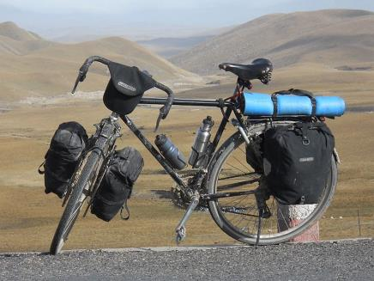
Mobility as an outcome of practice
Notes:
2 – Instead of doing mobility as a practice, focus on practices
Mobility by many different modes of transport as an outcome of practice
Already recognized in transport studies that people don’t necessarily travel for the sake of travel
Travel b/c take part in things that require mobility – e.g. going to work, to leisure spaces like campgrounds
Mobility here is a consequence of our participation in other practices
If take stronger version of practice as a unit – not just about people – so need to think about objects and how they move too
I’ve written about people moving around the things they need for leisure and how this affects not only where they go, but also how they can travel – travelling together with things – Hui 2012
e.g. only so much can fit in panniers – then may need a car to take more.
Seeing mobility as an outcome of practice has different consequences then – not about mode so much as how a particular practice like working as an academic, birdwatching, or being a member of parliament shapes understandings of what normal travel is and affects how people and things move together
15.30

Slide 16
Mobility infrastructures as part of practices
Notes:
A third reading of this relationship though could posit an even closer interrelationship of transport infrastructures and everyday practices.
Mobility infrastructures as part of practices themselves.
E.g. leisure walking – change from walking as dangerous, utilitarian to something for enjoyment and contemplation was facilitated by the circulation of Wordsworth’s writings and the development of railroads
Could argue it wouldn’t have developed without these infrastructures – or at least major places for walking might not include the Lakes and Peak District as they do
So saying that mobility infrastructures affect how practices change is therefore suggesting a more complex interdependency
So even if transport infrastructures have different implications for different practices, part of a complex co-evolution
Leads to questions about whether particular infrastructures are integral or optional parts of practices like leisure and work
Also – questions about how changes to infrastructures might have unintended consequences for a wide range of practices
17.30

Slide 17
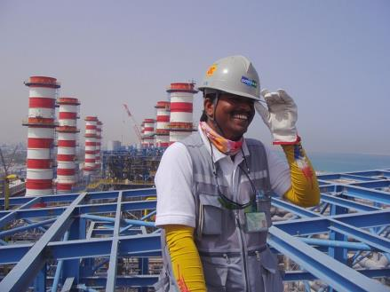
Infrastructures and policy as practices
Notes:
Finally – another reading of this intersection might look at the professional practices implicated in mobilities.
So – recognizing normal practices of infrastructural engineers and transport policymakers – these work practices have their own qualities and conventions
Specific understandings of mobility circulate within these professions, e.g. individual choice and idea of behaviour change as the way to a low carbon future
The implications of these planners and professionals are then embedded into their work
So roads, bus schedules, taxes as traces of professional practices that affect work, leisure, and everyday lives.
Understandings of mobility held by professions can be written into infrastructures that we then end up navigating
But since understandings and concepts are normal within these professions, changing them can be difficult if our research suggests they are limited
Difficult territory of multi-layered intersections without a common conceptual ground
19.05

Slide 18
The importance of intersections
How to steer demand shaped by understandings of mobilities + practices
Four intersections of mobilities + practices have different implications
Naming important actors and materialities
Politics and key interactions
Disciplines or professions of interest
What needs to transform
Notes:
So – brief introduction to different readings of the intersection of mobilities and practices – meant to highlight how much attempts to steer demand, or intervene in future mobilities, would be affected by how we approach this key intersection
Each of 4 framings
- Would suggest different things to be done to cut carbon emissions – from as simple as getting people to shift to different ways of travelling to recognizing how mobility co-evolves with other practices
Each reading of this intersection has consequences for:
Naming important actors and materialities
Politics of change and the key interactions affecting extent of change
Disciplines or professions enrolled in re-enacting particular articulation of the intersection
What might need to transform in future
**Therefore important to continue to engage at the intersections as contemplate how might steer mobility demand in the future.

Slide 19
Thank You!
Photo credits (all via Wikimedia commons unless noted)
Slide 3 – Abaconda Management Group
Slide 4 – Oosoom
Slide 5 – public domain; H Padleckas
Slide 6 – Greg Willis; Alex Proimos; Shafiq; Universalashic; public domain
Slide 7 – via theatlanticcities.com; via jonathandsolomon.com
Slide 8 – public domain; public domain; Luis Garcia
Slide 9 – public domain; Mike Gonzalez
Slide 10 – screen shot demand.ac.uk
Slide 12 – public domain; screen shot of http://theconversation.com/school-holiday-shakeup-brings-unintended-consequences-19399; Heb
Slide 13 - Shafiq
Slide 14 – screen shot of http://www.nationalarchives.gov.uk/films/1945to1951/filmpage_pc.htm
Slide 15 – mattbuck; Keithonearth
Slide 16 – Don Burgess
Slide 17 – C.M. Stieglitz; Jenieragav
@EverydayAllie
a.hui@lancaster.ac.uk
allisonhui.com
www.demand.ac.uk
@DEMAND_CENTRE

